Slide 1
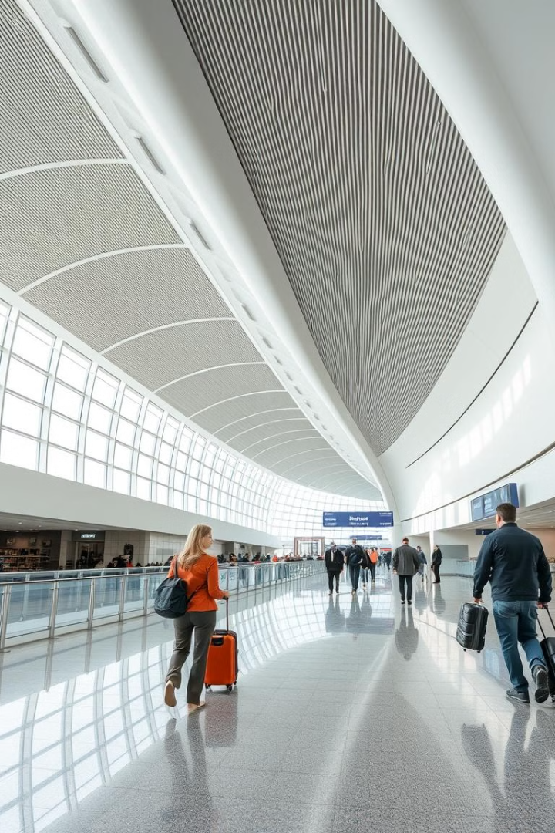

Java for Airline Reservation System
Java, with its robust object-oriented programming capabilities and vast ecosystem of libraries, provides an ideal foundation for building a comprehensive airline reservation system. This presentation will explore the key features, functionality, and technical aspects of implementing such a system using Java.
By Samarth shukla (23SCSE1180277)
Pavitra singh rawat (23SCSE1180388)
Priyanshu kumar(23SCSE1180531)
Pratham chaudhary(23SCSE1180064)

Slide 2
Overview of the Airline Reservation System
Booking Management
Schedule Management
Customer Management
Efficiently handle flight bookings, seat assignments, and real-time inventory updates.
Maintain a centralized database of flight schedules, routes, and departure/arrival times.
Provide a seamless user experience for customers to search, book, and manage their travel plans.

Slide 3
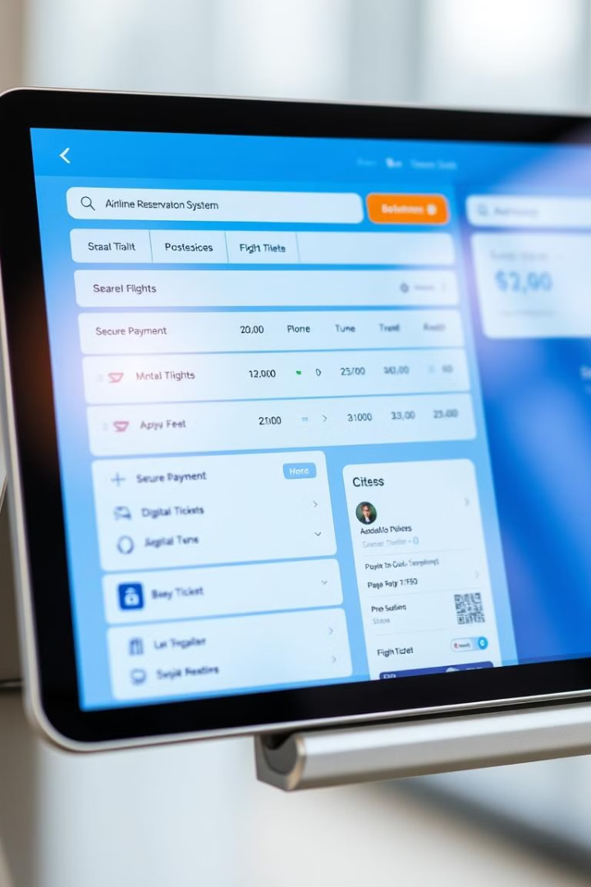
Key Features and Functionality
1
Comprehensive Search
2
Secure Booking and Payment
Allow users to search for flights based on a variety of parameters, such as departure/arrival locations, dates, and class of service.
Integrate with payment gateways to provide a seamless and secure booking experience for customers.
3
Passenger Management
4
Digital Ticketing
Manage passenger information, including contact details, frequent flyer programs, and special requests.
Offer paperless tickets and mobile boarding passes for a more efficient and eco-friendly travel experience.

Slide 4




Java Programming Concepts
Object-Oriented Design
Leverage Java's object-oriented programming paradigm to create modular and scalable application architecture.
Multithreading
Utilize Java's robust multithreading capabilities to handle concurrent booking requests and real-time updates.
Exception Handling
Implement robust error handling and logging mechanisms to ensure the system's reliability and stability.

Slide 5
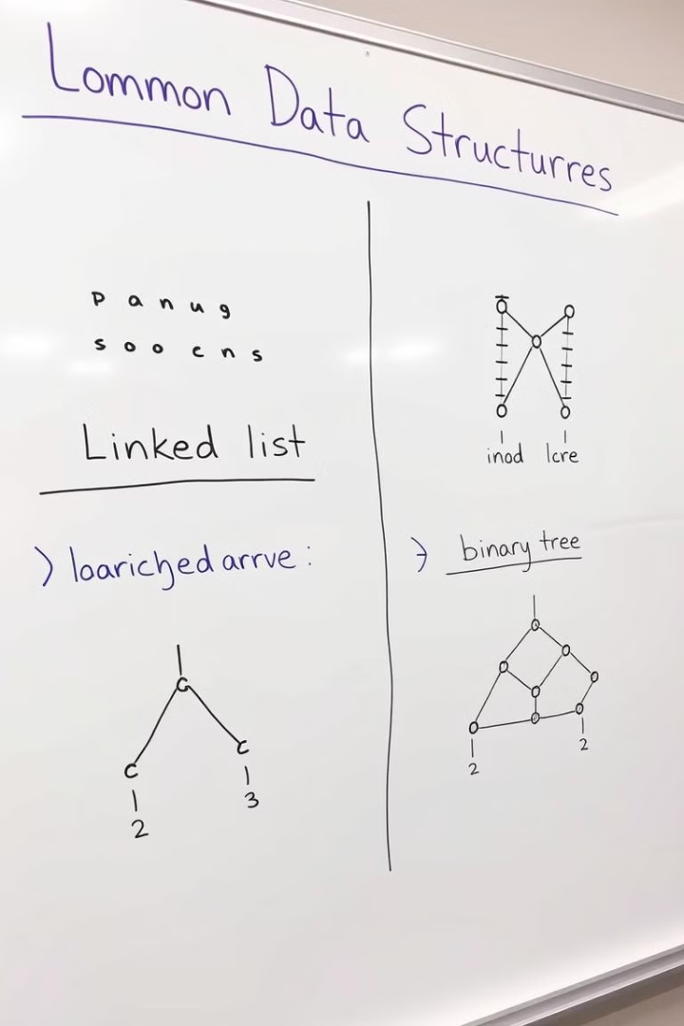
Data Structures and Algorithms
1
Efficient Searching
Use appropriate data structures, such as trees and hash tables, to enable fast flight search and availability lookup.
2
Seat Allocation
Apply algorithms like greedy or dynamic programming to optimize seat assignments and minimize conflicts.
3
Pricing and Fare Calculation
Implement complex pricing models and fare rules using advanced data structures and algorithms.

Slide 6
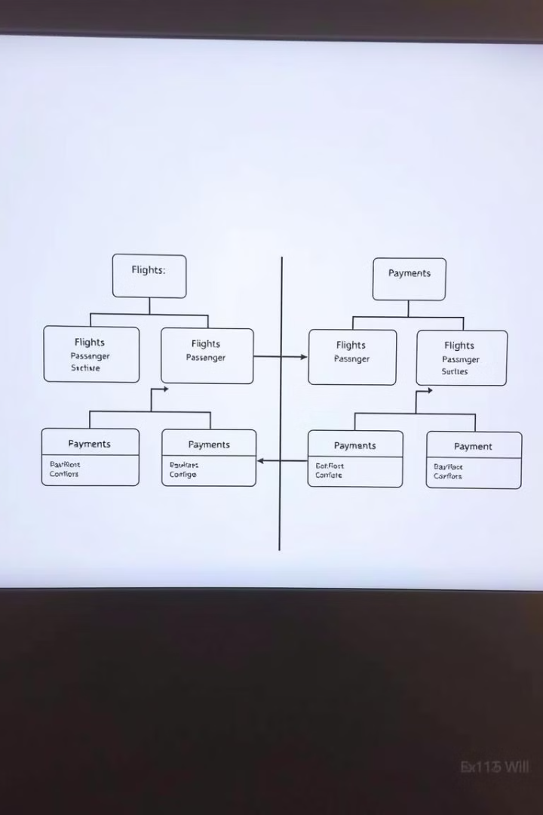




Database Integration
Flight Schedules
Store and manage comprehensive flight schedules, including route information, departure and arrival times, and seat capacity.
Passenger Records
Maintain a centralized database of passenger information, including contact details, frequent flyer status, and travel preferences.
Booking and Payments
Integrate with payment gateways to securely store and process booking and payment information.

Slide 7
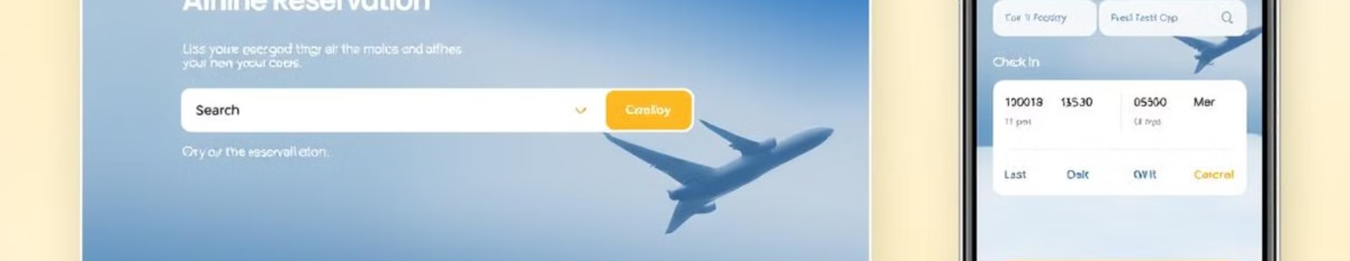
User Interface and User Experience
Responsive Design
Intuitive Navigation
Personalization
Ensure the system is accessible and optimized for various devices, including desktop, tablets, and mobile phones.
Provide a seamless user experience with clear and intuitive navigation, enabling customers to easily complete their travel-related tasks.
Offer personalized features, such as saved preferences and previous booking history, to enhance customer loyalty and satisfaction.

Slide 8

Deployment and Maintenance
Scalability
Ability to handle increasing user traffic and transaction volumes without compromising performance.
High Availability
Ensure the system remains operational and accessible to customers even during unexpected events or system failures.
Automated Processes
Implement automated mechanisms for tasks like software updates, backups, and monitoring to streamline maintenance activities.

